Slide 1
DATA 606 Capstone Project
Part 1 ~ by Carlotta Amaduzzi camaduz1@umbc.edu
as of February 27, 2022

Slide 2
Overview
Access to Higher Education is essential
to maintain a more equitable society
to inspire individual professional and financial growth
to ensure social mobility
Understanding the factors that influence undergraduate enrollment in Higher Education Institutions (HEIs) can have a double positive effect:
on the HEIs themselves which are for all practical purposes fairly large (business) organizations
on the impact increased levels of education can have on society as a whole

Slide 3
Research Focus
The questions I am interested in looking into are the following:
Based on publicly reported information regarding HEIs, what features seem to affect student enrollment choice the most?
With an eye to I.D.E.A. (Inclusion, Diversity, Equity, and Access), do HEIs with different structural characteristics, fare differently across the US?
Are new policies adopted by HEIs, such as standardized-tests-blind admission policies, having an effect on students’ enrollment?

Slide 4
The Data
The data initially used for this project is all publicly available information
The data was downloaded from the Integrated Postsecondary Education Data System (IPEDS) web site (https://nces.ed.gov/ipeds/datacenter/DataFiles.aspx )
It refers to different files of data relative to HEIs
Institutional ID data
Institutions Offerings
Students’ Enrollment data
Focus was placed exclusively on data directly reported by the HEIs themselves

Slide 5
Data Cleaning
During this initial phase of data cleaning primary focus has been placed on acquiring a sound sub-set of HEIs for which up-to-date data was available for the 2019-2020 academic year.
Dictionary files accompanying each datafile have been extensively used to identify the salient features retained for the analysis and to understand the reported data
The short-list of institutions selected will be used to complete a comparative analysis across time, if possible

Slide 6
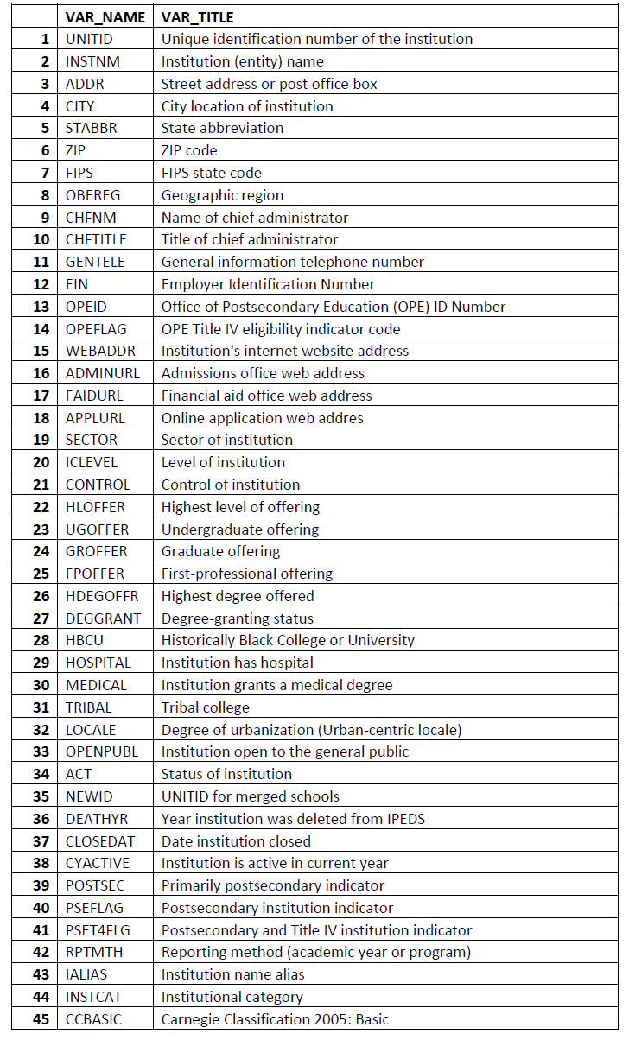
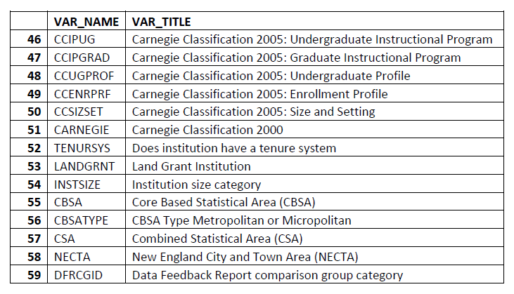
Institutional Descriptive data
Data File: hd2020.csv
Dictionary: hd2020.xls
The data file contains 59 different variables that help unequivocally identify each HEI
Final Selected features: (after data cleaning)
'UNITID’,
'INSTNM’
'STABBR’
'OBEREG’
'HLOFFER’
'GROFFER’
'HDEGOFFR’
'HBCU’
'LOCALE’
'POSTSEC’
'INSTCAT’
'INSTSIZE'

Slide 7
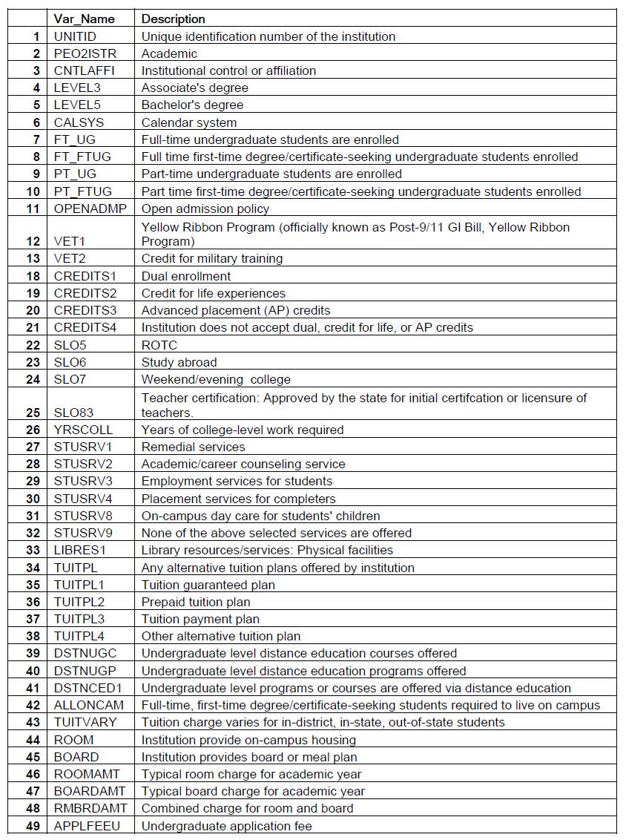
Services Offered Descriptive data
Data File: ic2020.csv
Dictionary: ic2020.xls
The data file contains 49 different variables that offer information regarding HEIs services offerings
Final Selected features: (after data cleaning)
'UNITID’
'CNTLAFFI’
'LEVEL3’
'LEVEL5’
'CALSYS’
'FT_UG’
'FT_FTUG’
'PT_UG’
'PT_FTUG’
'OPENADMP’
'VET1’
'VET2’
'CREDITS1’
'CREDITS2’
'CREDITS3’
'CREDITS4’
'SLO5‘
’SLO6’
'SLO7’
'SLO83’
'YRSCOLL’
'STUSRV1’
'STUSRV2’
'STUSRV3’
'STUSRV4’
'STUSRV8’
'STUSRV9’
'LIBRES1’
'TUITPL’
'TUITPL1’
'TUITPL2’
'TUITPL3’
'TUITPL4’
'DSTNUGC’
'DSTNUGP’
'DSTNCED1’
'ALLONCAM’
'TUITVARY’
'ROOM’
'BOARD’
'APPLFEEU’
'RMANDBRDAMT'

Slide 8
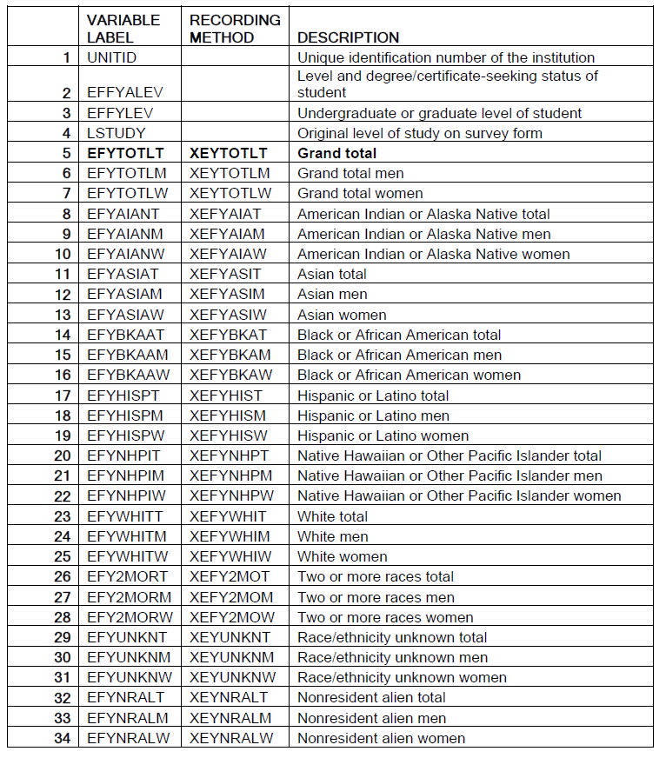
Student Enrollment data
Data File: effy2020.csv
Dictionary: effy2020.xls
The data file contains 34 different variables that offer information regarding HEIs students (not including 30 Imputation Variables)
'UNITID’
'EFYTOTLT’
'EFYTOTLM’
'EFYTOTLW’
'EFYAIANT’
'EFYAIANM’
'EFYAIANW’
'EFYASIAT’
'EFYASIAM’
'EFYASIAW’
'EFYBKAAT’
'EFYBKAAM',
'EFYBKAAW’
'EFYHISPT’
'EFYHISPM’
'EFYHISPW’
'EFYNHPIT’
'EFYNHPIM',
'EFYNHPIW’
'EFYWHITT’
'EFYWHITM’
'EFYWHITW’
'EFY2MORT’
'EFY2MORM’
'EFY2MORW’
'EFYUNKNT’
'EFYUNKNM’
'EFYUNKNW’
'EFYNRALT’
'EFYNRALM’
'EFYNRALW'

Slide 9
Current Status of the data
The files have been merged and the data cleansed
The institutions shortlisted are 3547
The data refers to 59 US States & Territories
The current data refers only to 2019-2020

Slide 10
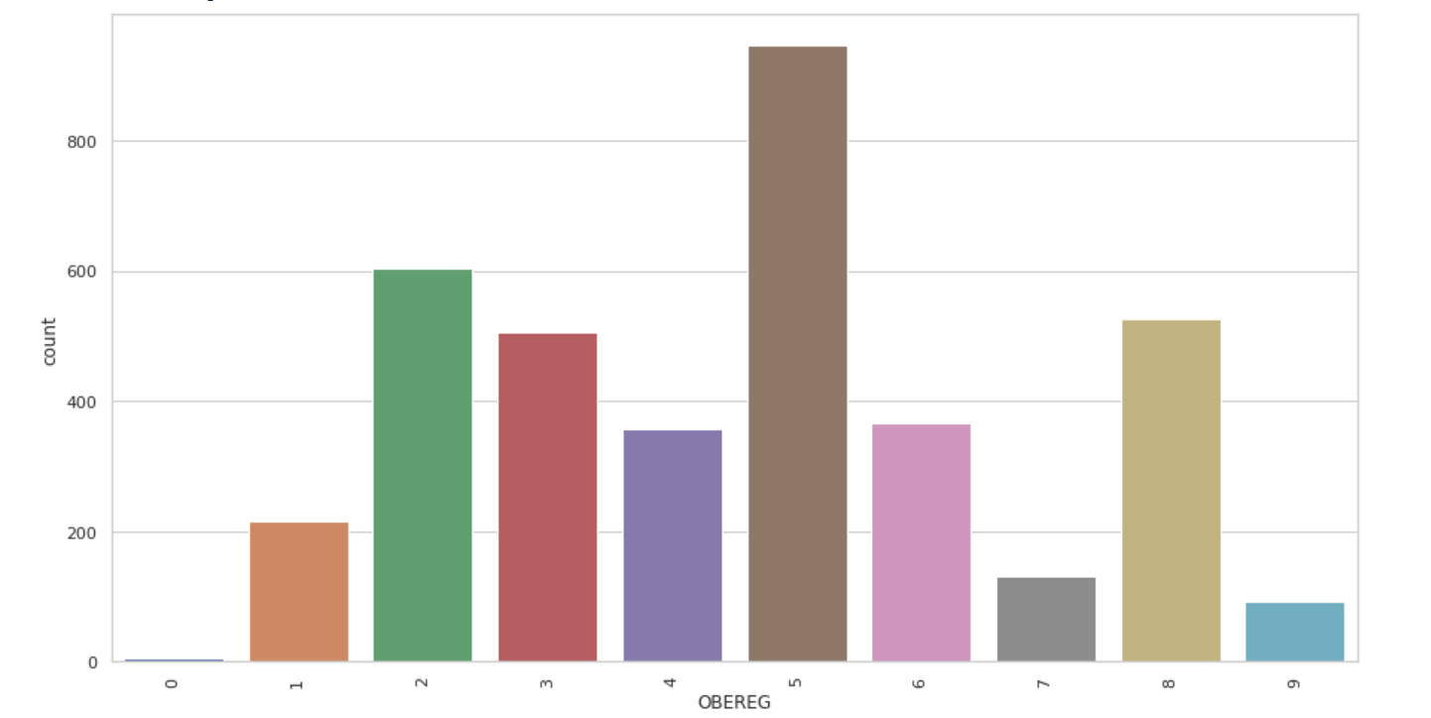
Initial Exploratory Analysis
While not specifically tied to the Research Questions a couple of initial data visualizations have been created
The graph to the right represents the distributions of HEIs across the Bureau of Economic Analysis’ categories.
# 0 - US Service schools # 1 - New England CT ME MA NH RI VT
# 2 - Mid East DE DC MD NJ NY PA # 3 - Great Lakes IL IN MI OH WI
# 4 - Plains IA KS MN MO NE ND SD # 5 - Southeast AL AR FL GA KY LA MS NC SC TN VA WV # 6 - Southwest AZ NM OK TX
# 7 - Rocky Mountains CO ID MT UT WY
# 8 - Far West AK CA HI NV OR WA # 9 - Outlying areas AS FM GU MH MP PR PW VI - (Not in the Continental USA)

Slide 11
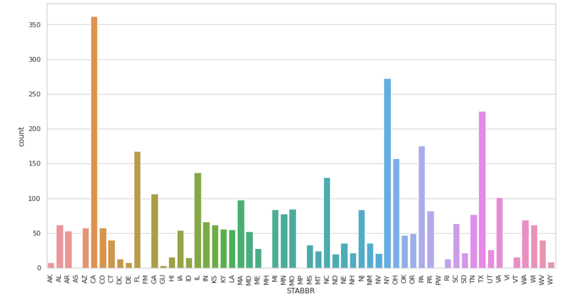
Initial Exploratory Analysis
While not specifically tied to the Research Questions a couple of initial data visualizations have been created
The graph to the right represents the distributions of HEIs by Stateand US Territory.

Slide 12
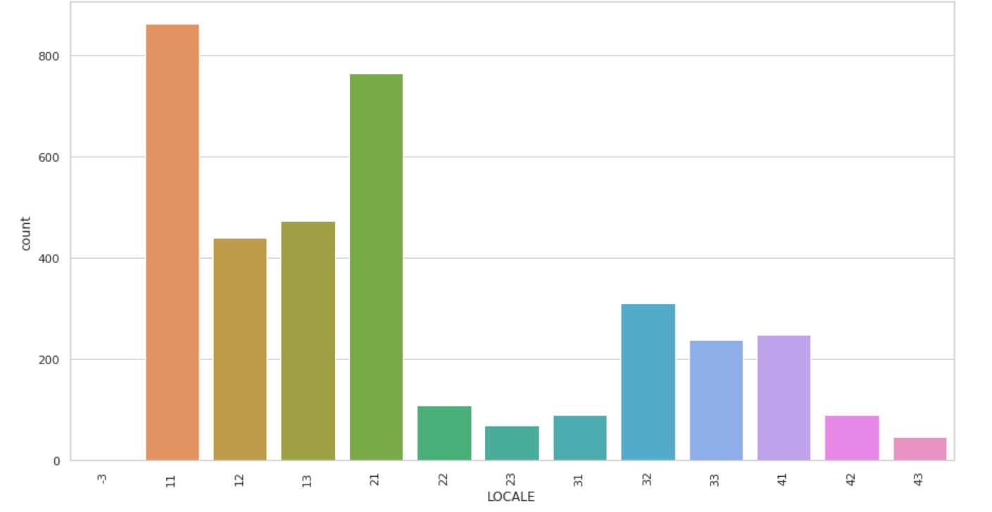
Initial Exploratory Analysis
While not specifically tied to the Research Questions a couple of initial data visualizations have been created
The graph to the right represents the distributions of HEIs by type of local environment they are set into (urban vs rural vs sub-urban)
Code -3 = Territories Outside the Continental US
Codes 11-13 = City (Large, Midsize, Small)
Codes 21-23 = Suburb (Large, Midsize, Small)
Codes 31-33 = Town (Fringe, Distant, Remote)
Codes 41-43 = Rural (Fringe, Distant, Remote)

Slide 13
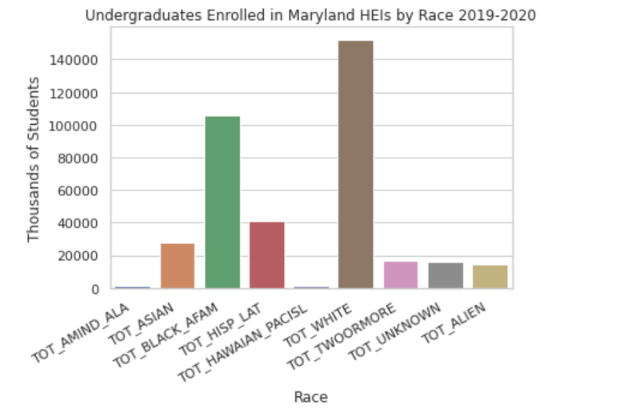
Initial Exploratory Analysis
While not specifically tied to the Research Questions a couple of initial data visualizations have been created
The graph to the right represents the distributions of Student Enrollment in HEIs who offer Undergraduate Programs by ethnicity
American Indian and Alaska Native
Asian
Black and African American
Hispanic or Latino
White
Two-or more races
Undisclosed Ethnicity
Non-Resident-Alien)

Slide 14
Intended next steps
- Verifying data scales
- Separating out a test set to avoid increasing the models’ bias
- Continue with some additional data visualizations
- Correlation Analysis of the features
- Completing final data preparation to ensure that the ML Algorithms run smoothly (for example using scaling techniques, labeling categorical data, dealing with outliers etc.)
- Select the best ML models (Regression Model; possibly DBSCAN for clustering; Feature Selection optimization via Principal Component Analysis)
-Extracting the shortlisted Institutions’ data across different years

